Slide 1





Slide 2




Slide 3

Creating a classroom where we all….
feel we belong,
share our ideas,
feel safe,
and enjoy being in.

Slide 4






Pleased to Meet You!
Option 1
Pair up with someone you don’t usually work with
Introduce yourself to each other
Take turns rolling a dice, answer the question that matches the number you rolled:
What is your favorite game?
What’s something that makes you laugh?
What school subject is easiest for you?
What’s something that makes you frustrated?
What’s something you like to do outside
of school?
Who lives in your household (pets included)?

Slide 5






Pleased to Meet You!
Option 2
Pair up with someone you don’t usually work with
Introduce yourself to each other
Take turns rolling a dice, answer the question that matches the number you rolled:
What is your favorite…and why?
food
book
game
place
animal
job

Slide 6
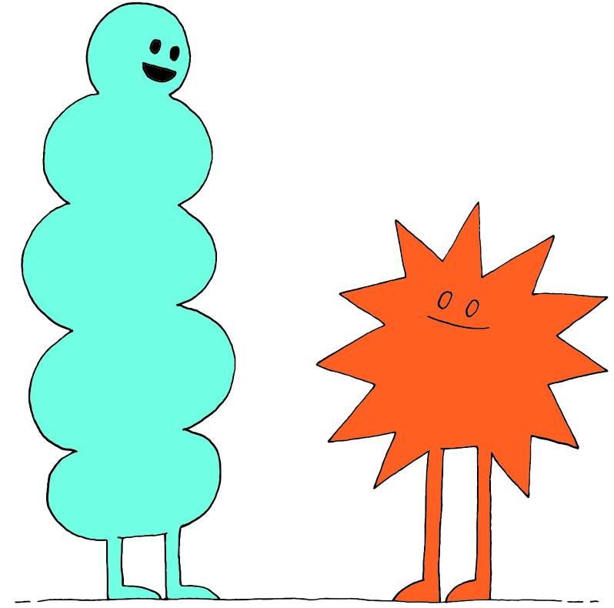
Share Out!
What is one thing you learned about your partner?

Slide 7
Would You Rather
I will ask the “would you rather” question
If you prefer option 1, go to the left side of the room
If you prefer option 2, go to the right side of the room.
3. Once on your side of the room, discuss with the group why you chose that option
4. After a brief discussion, we’ll have a friendly debate between groups on why their choice is best.
Notes:
Teacher Note: Another option here is to save this game for lesson 2!

Slide 8
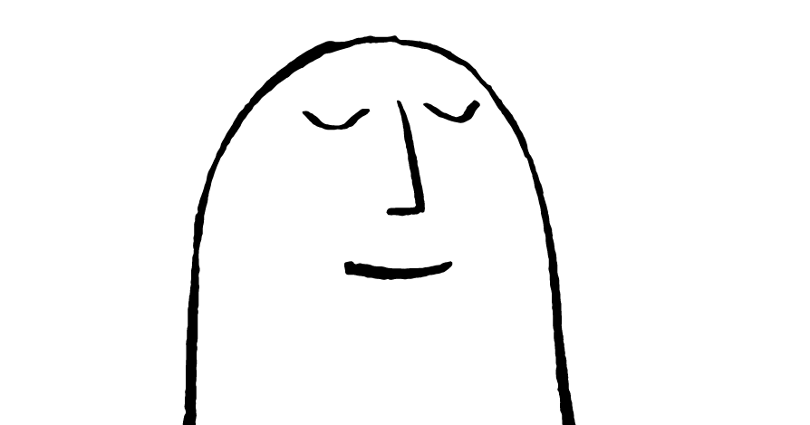

Would You Rather
Would you rather…
Be able to fly OR be invisible?
Move to the left side
Move to the right side

Slide 9
Would You Rather
Would you rather…
Only eat your 2 favorite foods for the rest of your life
Never eat them again
OR
Move to the left side
Move to the right side

Slide 10
Would You Rather
Would you rather…
Be a teacher
Be a student
OR
Move to the left side
Move to the right side

Slide 11
Would You Rather
Would you rather…
Make lots of money
Love your job
OR
Move to the left side
Move to the right side

Slide 12
Would you rather
Would you rather…
Live in a cave
Live in a treehouse
OR
Move to the left side
Move to the right side

Slide 13


What is a Community?
Think-Pair-Share
What makes a community?
What types of communities can you think of?

Slide 14



What is a Community?
Brainstorm:
What types of communities can you think of?
Independent Writing
What do these communities have in common?
How are they different?
What tools and practices do you think these communities use in order to succeed?

Slide 15
Share Out!
Share your writing with a partner.
Then, we’ll share discuss as a class.

Slide 16
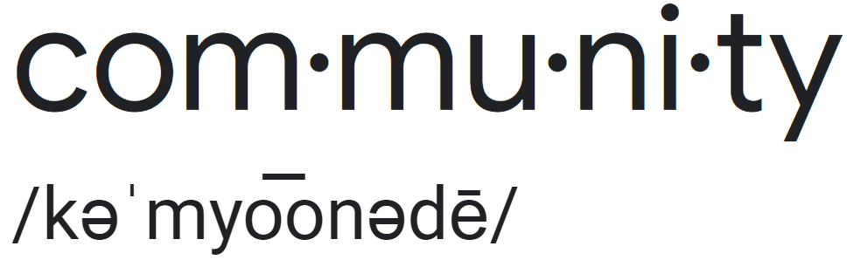
Community Definition
noun
Definition: a group of people with a common characteristic or interest living together within a larger society.
Think-Pair-Share
How does the definition relate to our classroom?
What do we have in common?
Why are we all here?
What is our purpose as a community?

Slide 17

Caring
Think-Pair-Share
What does the word “caring” mean?

Slide 18
Caring Community
Look like? What do you see in a caring community? | Sound like? What do you hear in a caring community? | Feel like? What do you feel when YOU are in a caring community?

Slide 19
Brainstorm
What are examples of caring words?
What are examples of caring actions?

Slide 20
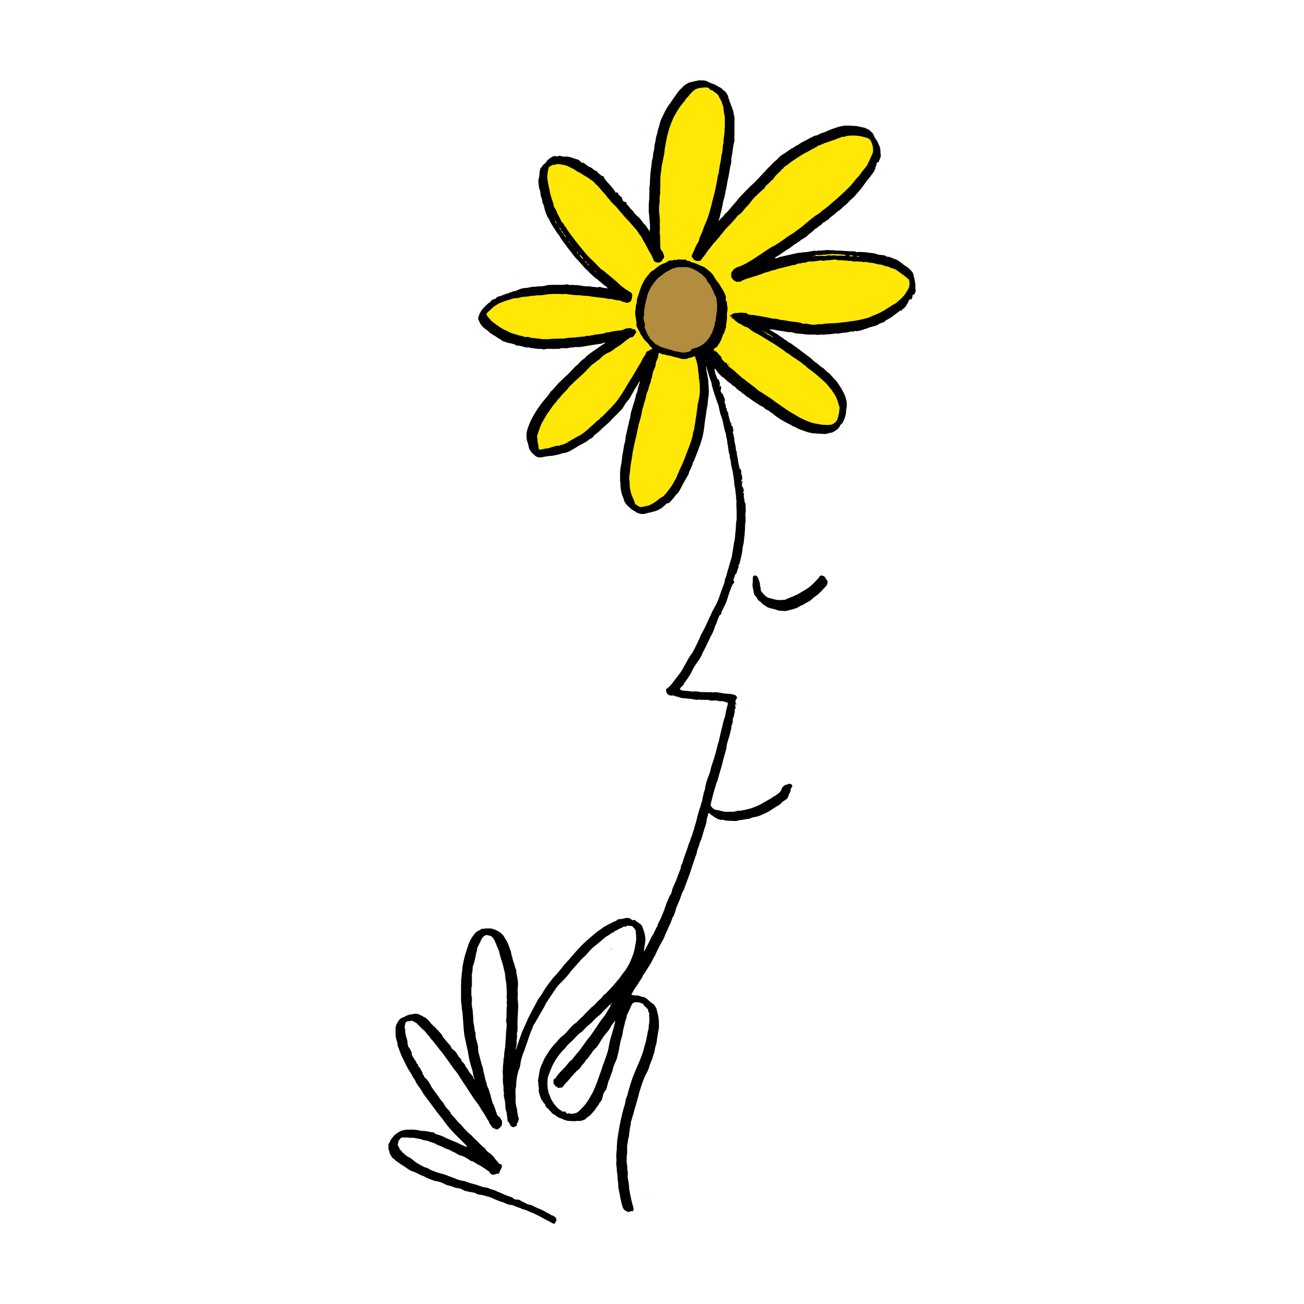
Caring Classroom
Think-Pair-Share
What type of classroom community would you like to learn in?

Slide 21

Caring Classroom
Independent Writing
What would you like our community to be like?
How can you contribute to our caring classroom community?
Write down some key things that are important to you in our community.

Slide 22
Share Out!
Share your thoughts from your writing.

Slide 23
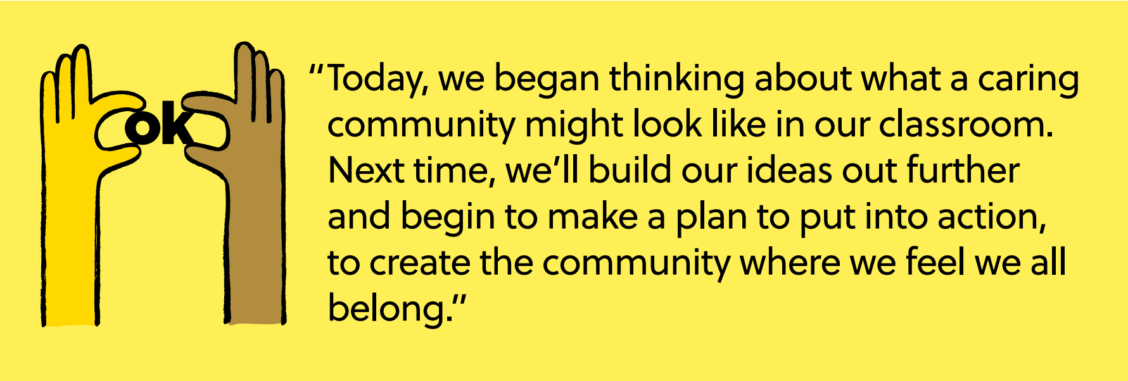
Reflect and Celebrate

Slide 24
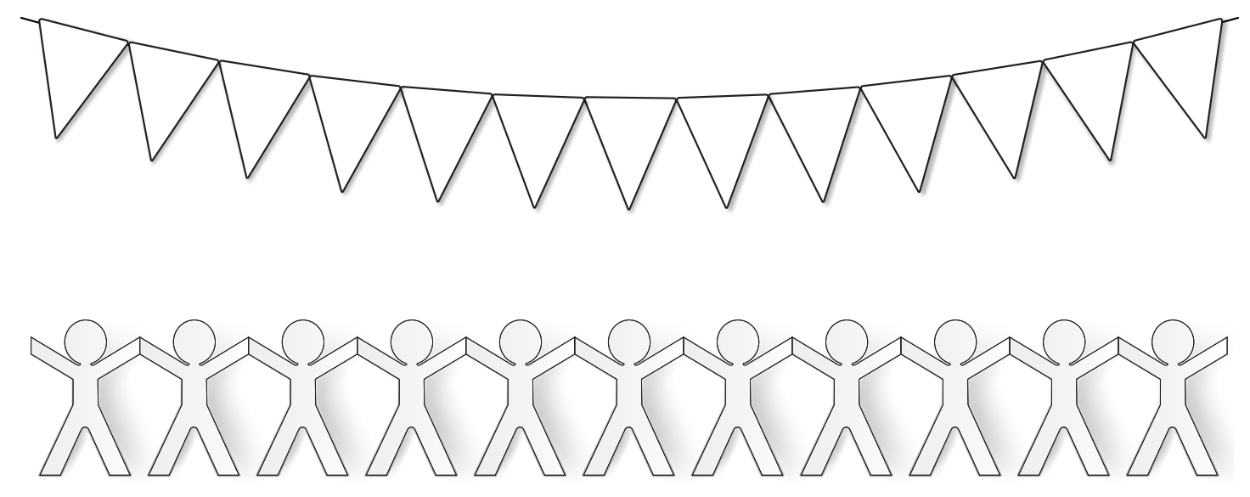
Reflect and Celebrate
Independent Writing
Whether on a triangle or cut-out person for a banner or making a poster, draw or write about something you learned about a caring classroom community.

Slide 25
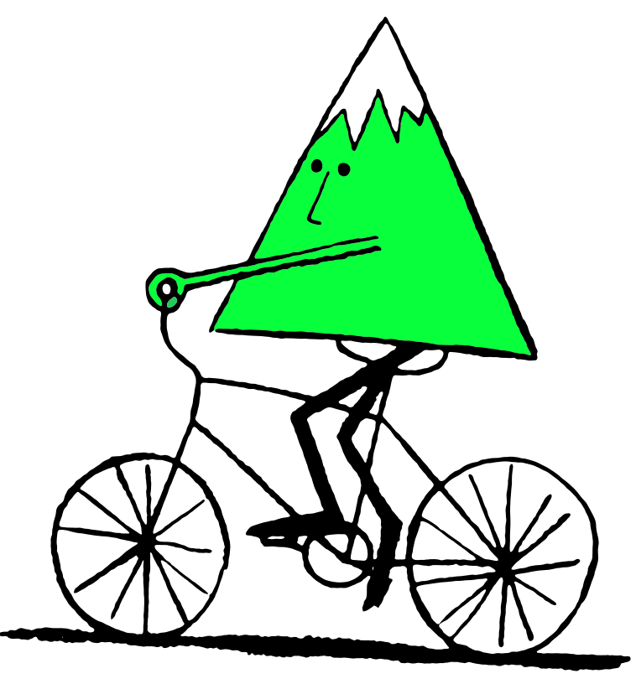



Slide 26
Start us off!
Think-Pair-Share
How can we honour the differences between each other?

Slide 27
Review
What ideas did we have on what makes a caring classroom?
Is anything missing from our ideas?
Can you give specific examples on how we should:
    Speak to each other
    Solve problems or disagreements
    How we want to feel in class

Slide 28
Brainstorm Around the Room
What does a caring classroom look like?
What does a caring classroom sound like?
What does a caring classroom feel like?
Notes:
Teacher Note: options-
Create 3 anchor charts with these titles at the top. Invite students to work in small groups to write their ideas on each one
Allow students to make their own posters/journal pages with each of these categories

Slide 29
Share Out!
What do you notice about our brainstorm
Are there common themes?
Is there anything missing?

Slide 30
Small Group Discussion
Think-Pair-Share
What 3-5 ideas from our brainstorm do you think are most important?

Slide 31
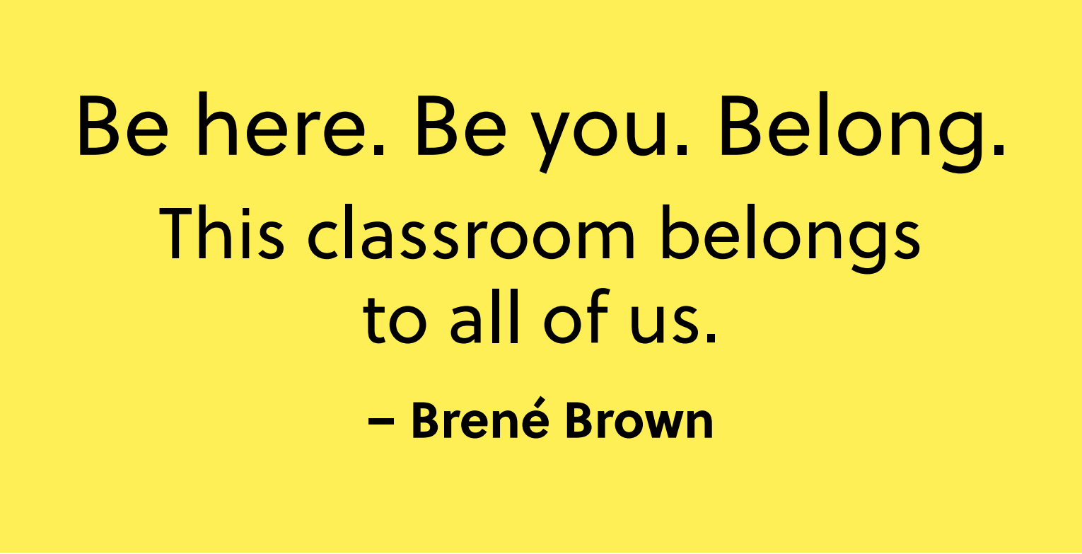
Reflection
Independent Writing
Write or draw a quiet reflection on the work we’ve done on building a caring classroom community.

Slide 32
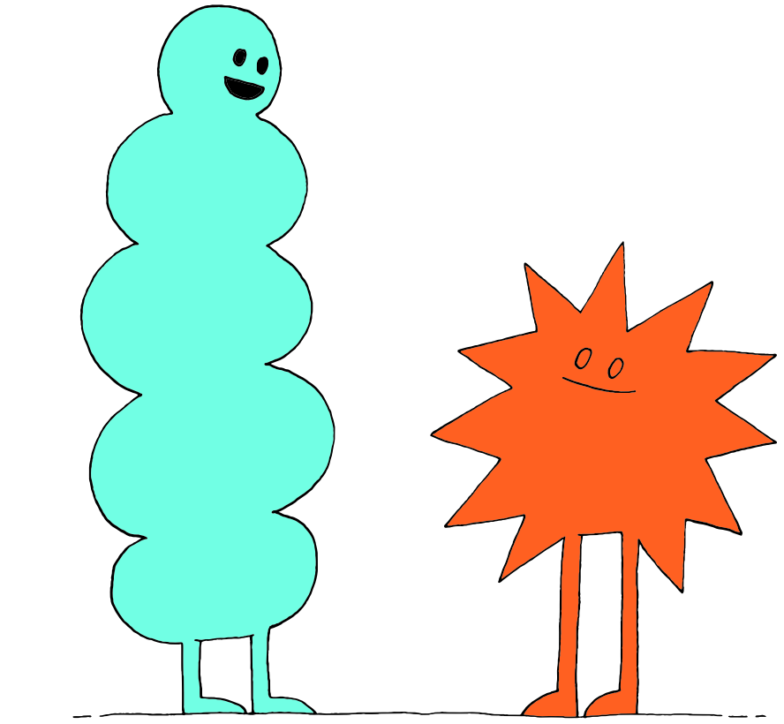



Slide 33
Review
What does a caring classroom:
  Look like?
  Sound like?
  Feel like?
What ideas did you feel were most important from our brainstorm?

Slide 34
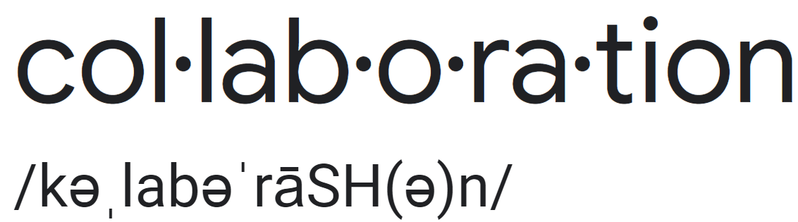
What is Collaboration?
noun
Definition: working with others to produce or create something.
Think-Pair-Share
What skills would you need to collaborate?

Slide 35

Classroom Community Plan
Today we will be working collaboratively to create a plan for our caring classroom community!

Slide 36
Review
What does a caring classroom:
  Look like?
  Sound like?
  Feel like?
What ideas did you feel were most important from our brainstorm?

Slide 37
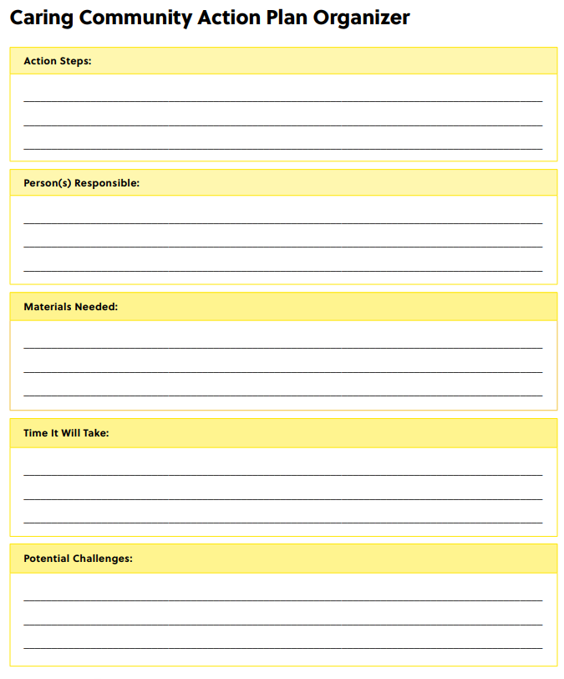
Caring Community Plan
Action Steps:
What actions need to happen to create a caring community?
Person(s) Responsible:
Who needs to take those actions? Does everyone have the same responsibilities?
Materials Needed:
What do those people need to make the actions happen?
Time it Will Take:
How much time will the people need to dedicate to the actions?
Potential Challenges:
What could make creating a caring community difficult?

Slide 38
Step 1
Work with your group to complete a Caring Community Action Plan

Slide 39
Step 2
Share your ideas with the class.

Slide 40
Step 3 optional
Vote on what you think was most important from each group’s plan.

Slide 41
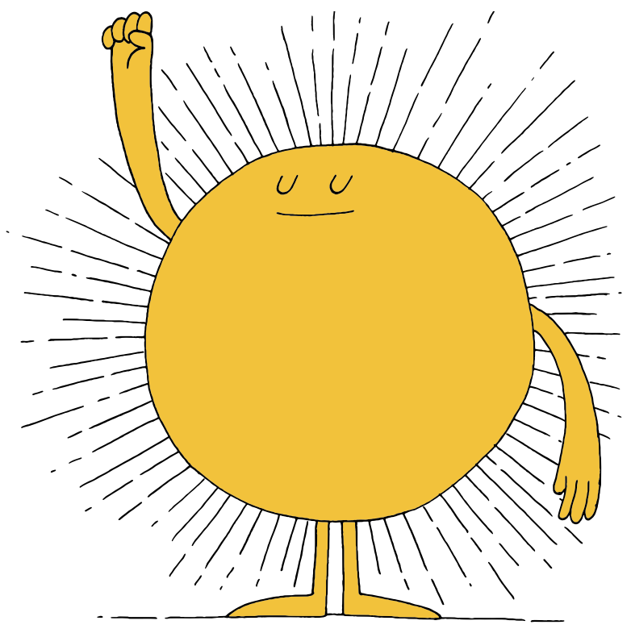
Let’s Do it!
In our next lesson, we are going to put our plan into action!

Slide 42



Slide 43
Caring Classroom Review
Think-Pair-Share
Reflect on the process so far:
Have you felt included in creating a caring classroom plan?

Slide 44
Share Out!
Have you felt included in our caring classroom planning?
Why do you think it’s important that everyone feel connected to the process and to each other?

Slide 45
Process Review
What does a caring classroom look like?
What does a caring classroom sound like?
What does a caring classroom feel like?
Remember, the goal is to create a safe, caring classroom environment
Think of our key learnings from the above activities
How can we not only create that environment, but maintain it?

Slide 46
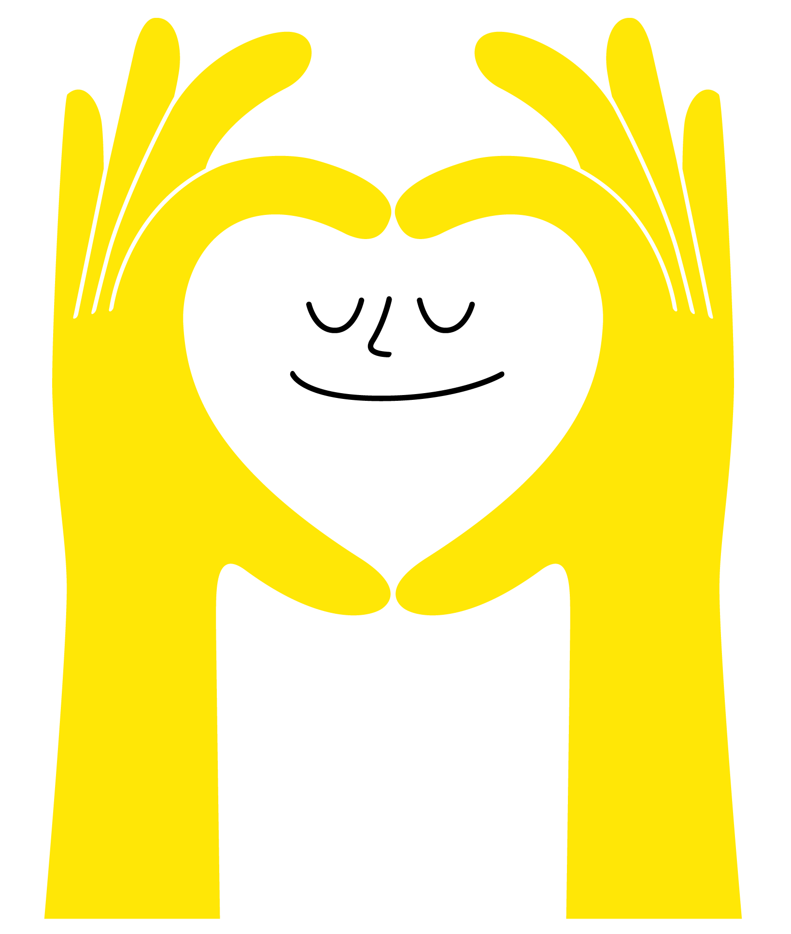
Action Time!
It’s time to take our ideas and put them into action!
What will your first step be?
What can we do to help if someone forgets our plan?
How can we make sure we maintain our plan until the end of the year?

Slide 47
Dear Future Self…
Independent Writing
Imagine yourself on the last day of school. Write a letter to your future self reminding yourself about this caring classroom process.
How did you feel during the process?
What did you learn about yourself and your classmates?
What did you enjoy and what were some challenges?
Also, feel free to include positive messages, like what you’ve done well so far this year and things you’re proud of!
Notes:
Teacher Note: Save these letters and deliver them back to students on the last day of school

Slide 48




Slide 49


A Walk Down Memory Lane
Independent Writing
How are you feeling now, after our work together?
What are some key learnings you can bring with you even after this year is over or in other parts of your life?
How do you think our year together may have been different if we didn’t do this activity?
What more would you like to contribute to our community?

Slide 50
Partner Reflection
Think-Pair-Share
Share your reflection with your partner

Slide 51
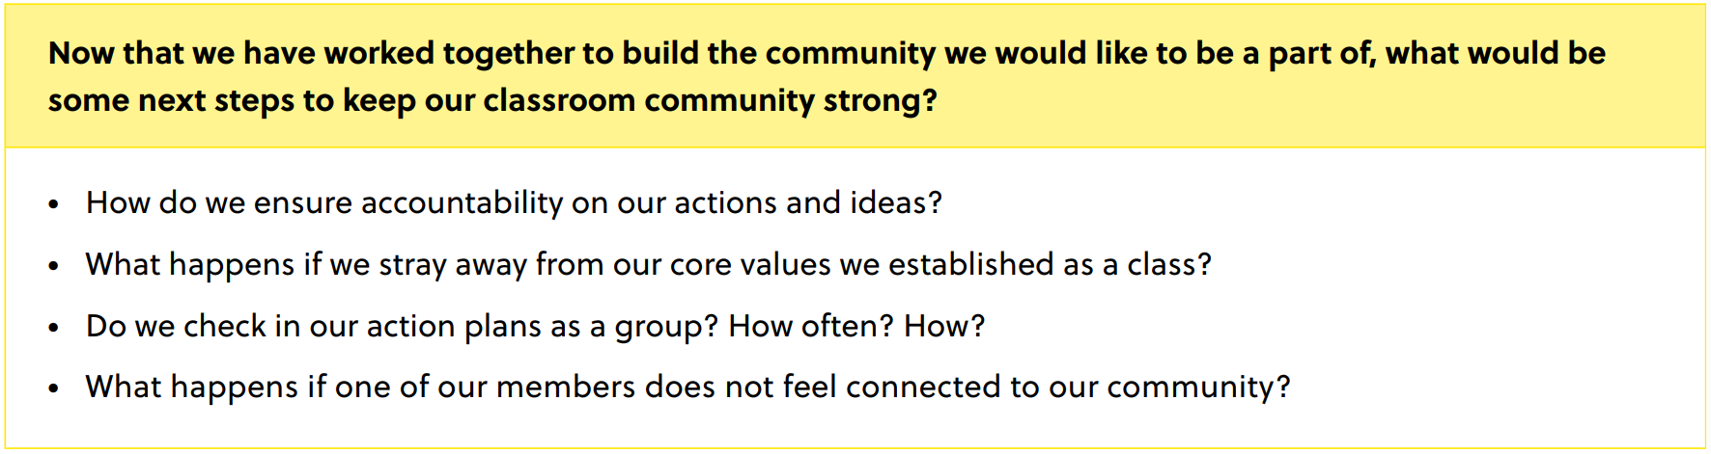
Share Out!

Slide 52
Final Thoughts
Independent Writing
Now that you’ve talked with a partner and we’ve discussed as a class, add any final thoughts to your reflection.

Slide 53
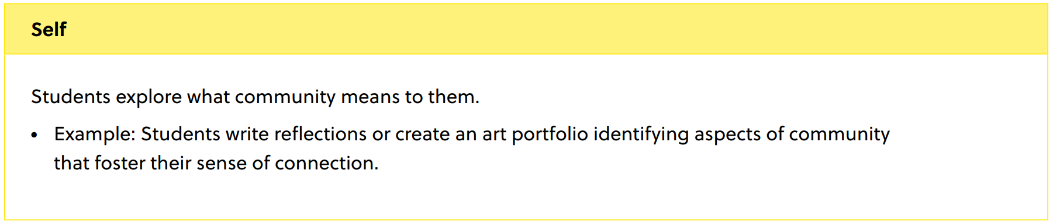
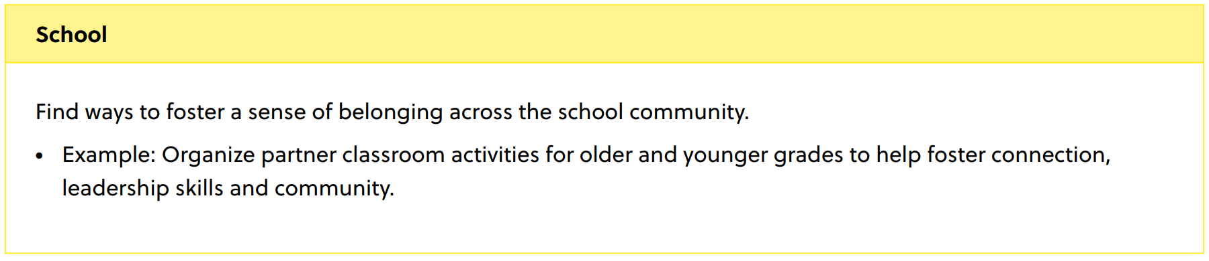

Simple Actions to Strengthen Community

Slide 54
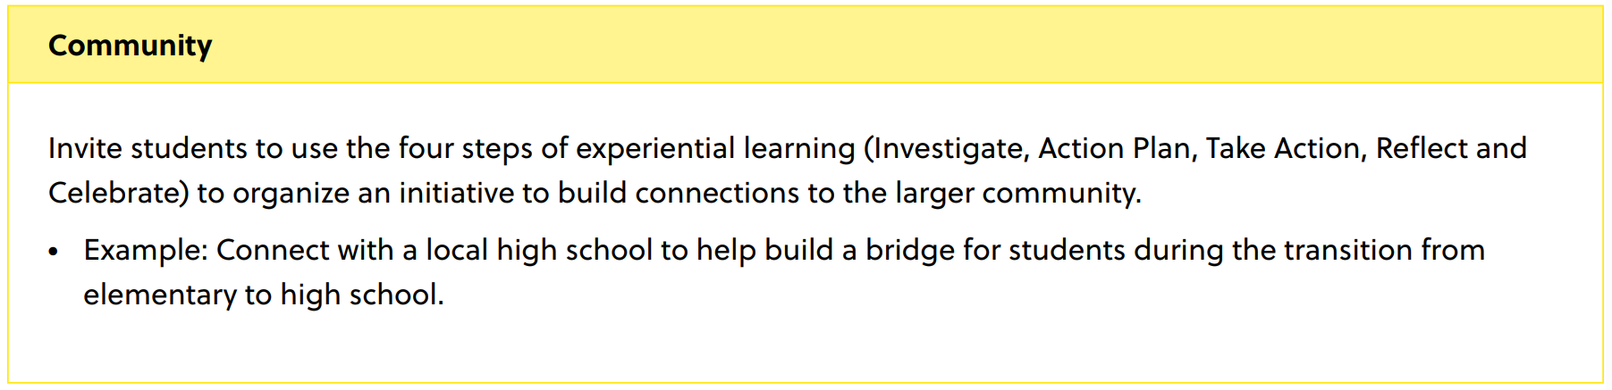
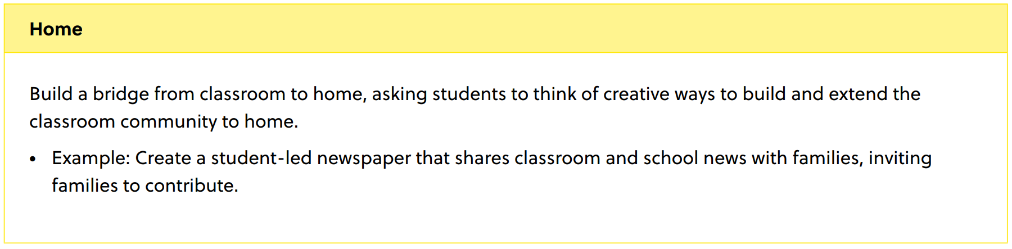
Simple Actions to Strengthen Community

Slide 55
